Slide 1
Small Hydro

Slide 2
OUTLINE
Hydropower Plants
Classifications
Different Layouts of Hydropower Plants
Concept of Power Generation
Hydro turbines

Slide 3
Hydropower Plants
Hydropower plant uses potential energy of water.
It converts potential energy into electrical energy.
It is renewable form of energy.
Application of hydropower plants:
Generation of electric power.
Storage of irrigation water.
Control of floods in the river.
Storage of drinking water supply.

Slide 4
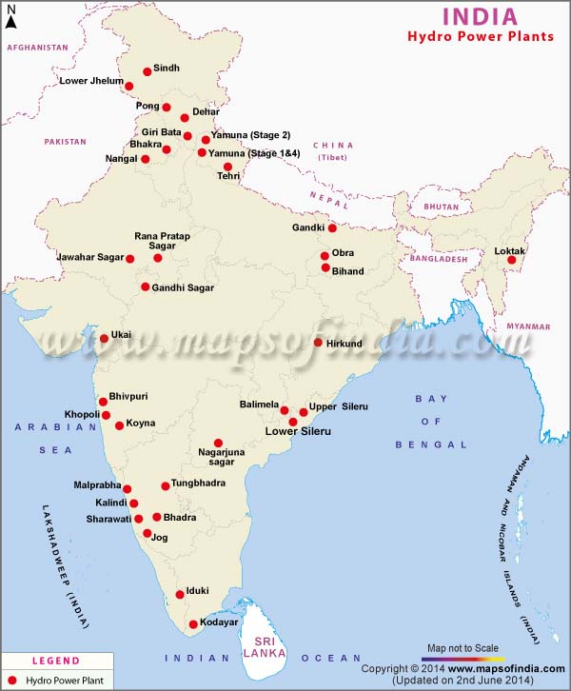
Hydropower Plants in India
Kadana
Sardar Sarovar

Slide 5
Hydropower Plants in Gujarat
Name of Plant | River - District | Capacity | Type of Turbine
Sardar Sarovar | Narmada - Narmada | 6 x 200 MW = 1200 MW 5 x 50 MW = 250 MW 1450 MW | Reversible Francis Kaplan
Ukai | Tapi – Surat & Tapi | 4 x 75 MW = 300 MW | Kaplan
Kadana | Mahi - Mahisagar | 4 x 60 MW = 240 MW | Reversible Francis (2) Francis (2)

Slide 6
2. Classifications
Dependent on Capacity:
Depending on Head:
Size | Unit size
Micro | Upto 100 kW
Mini | 101 to 1000 kW
Small | 1 to 25 MW
Ultra low head | Below 3 m
Low head | Less than 30 m
Medium head | Between 30 to 75 m
High head | Above 75 m

Slide 7
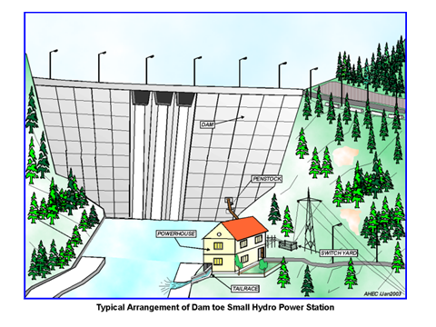
3. Different Layouts of Hydropower Plants
Layouts of Dam based Hydropower Plant (Front view)

Slide 8
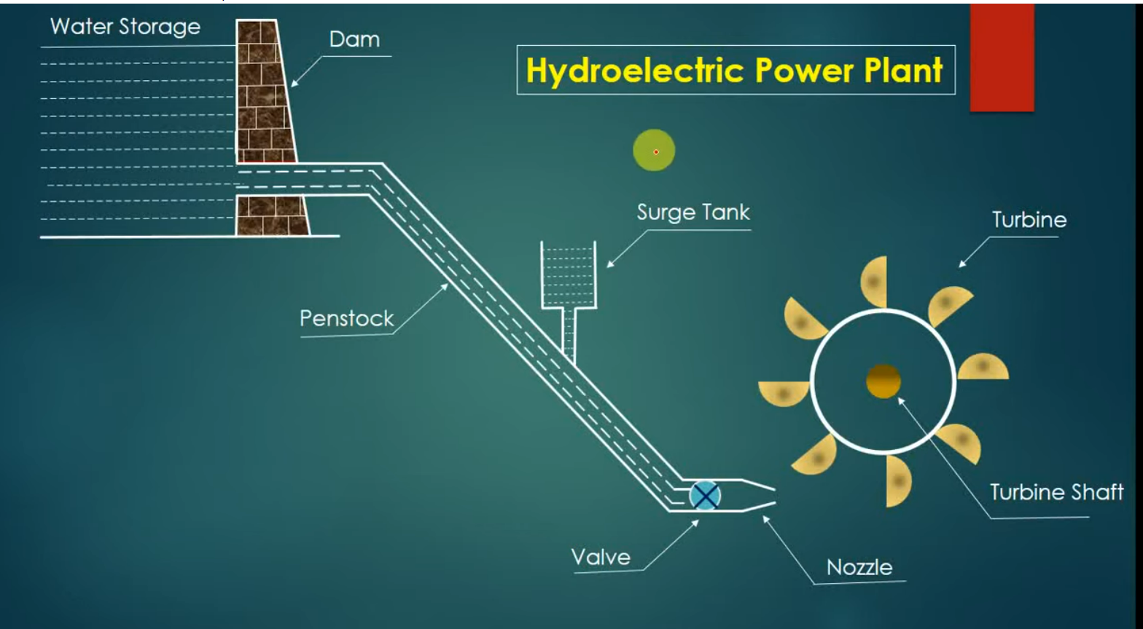
Layouts of Dam based Hydropower Plant (Side view)

Slide 9
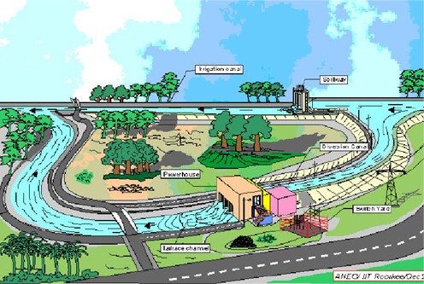
Layouts of Canal based Hydropower Plant

Slide 10
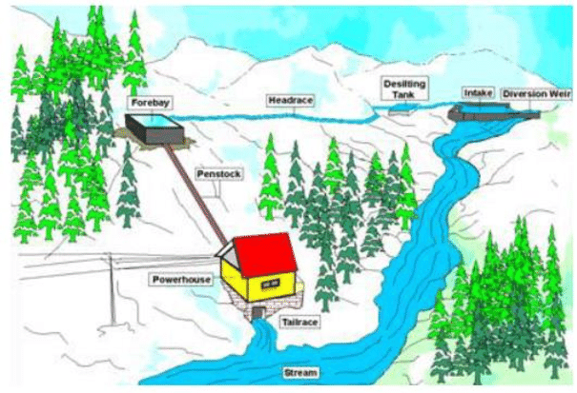
Layouts of River based Hydropower Plant

Slide 11
Major Components of a Hydropower Plants
Diversion and intake
Desilting chamber
Water conductor system
Forebay / balancing reservoir
Surgetank
Penstock
Powerhouse – turbine, generator etc.
Tail race channel

Slide 12
4. Concept of Power Generation

Slide 13
5. Hydro Turbines
CLASSIFICATION OF TURBINES
Impulse
Reaction
Pelton turbine
Mixed Flow
Axial Flow
Francis turbine
Kaplan turbine
Bulb turbine
Tube turbine
Straflo turbine

Slide 14
Suitability of Turbines
Turbine | Principle | Type of flow | Head | Discharge | Specific speed
Pelton | Impulse | Tangential | High | Low | Low
Francis | Reaction | Mixed (radial entry, axial exit) | Medium | Medium | Medium
Kaplan | Reaction | Axial | Low | High | High

Slide 15
Impulse Turbine
All the pressure energy is converted into kinetic energy in Nozzle and then pressure remains constant.
Reaction Turbine
As water passes through the casing the pressure to kinetic energy conversion took place gradually.
The work is done on the blades by the combined effects of impulse and reaction.

Slide 16
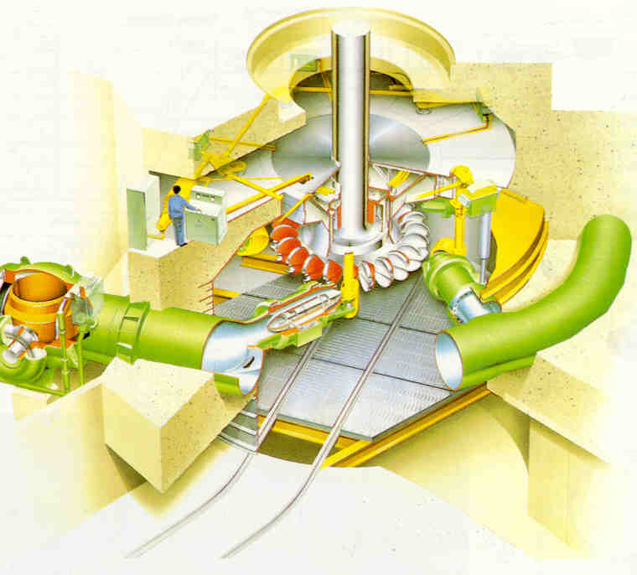
Pelton Turbine
Impulse turbine
Tangential flow
For high head
& low discharge
For low specific speed

Slide 17
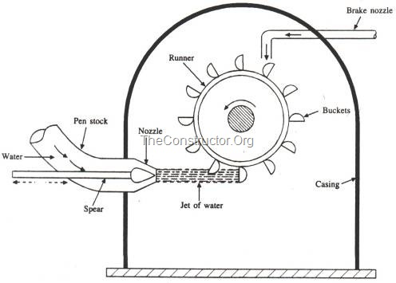
Main Components
Runner (wheel)
Buckets
Nozzle
Spear (valve)
Casing
Braking nozzle
Governing mechanism

Slide 18
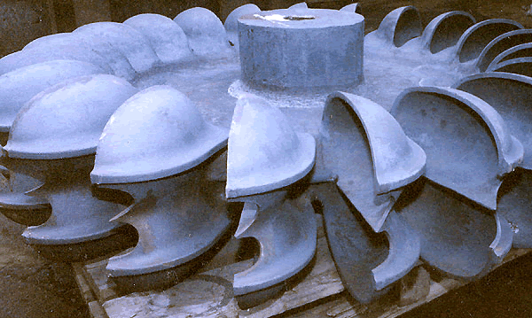
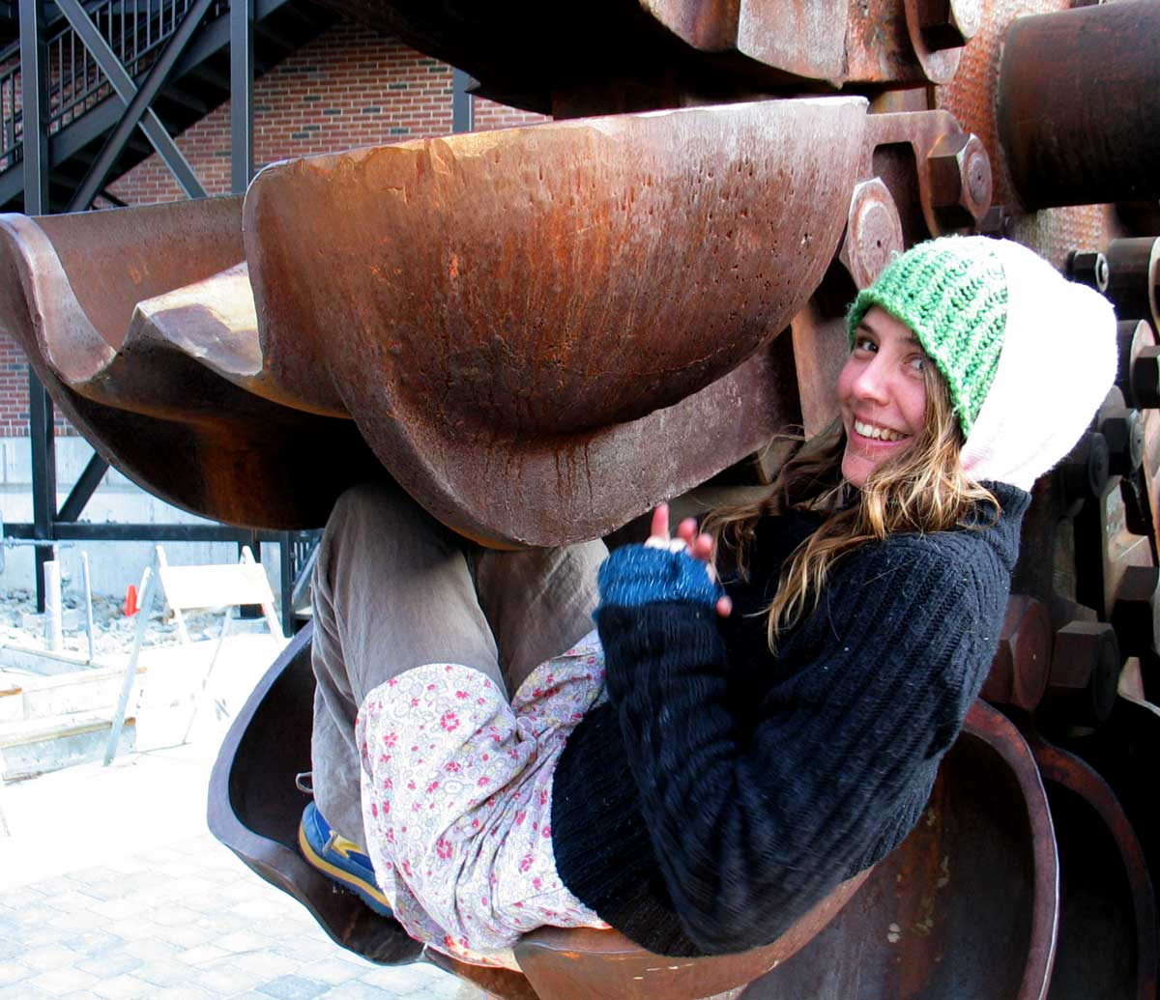
Pelton Wheel

Slide 19
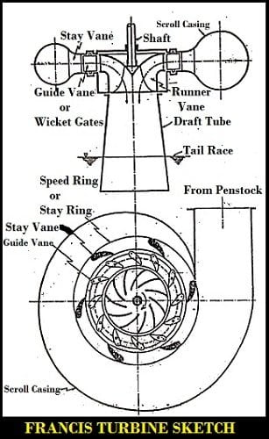
Main components
Francis Turbine
Francis is inward flow reaction or mixed flow type
It is used for medium head, medium discharge and medium specific speed.
Runner with runner vanes
Guide vanes (with guide wheel)
Spiral Casing
Draft tube
[Stay vanes are optional]

Slide 20
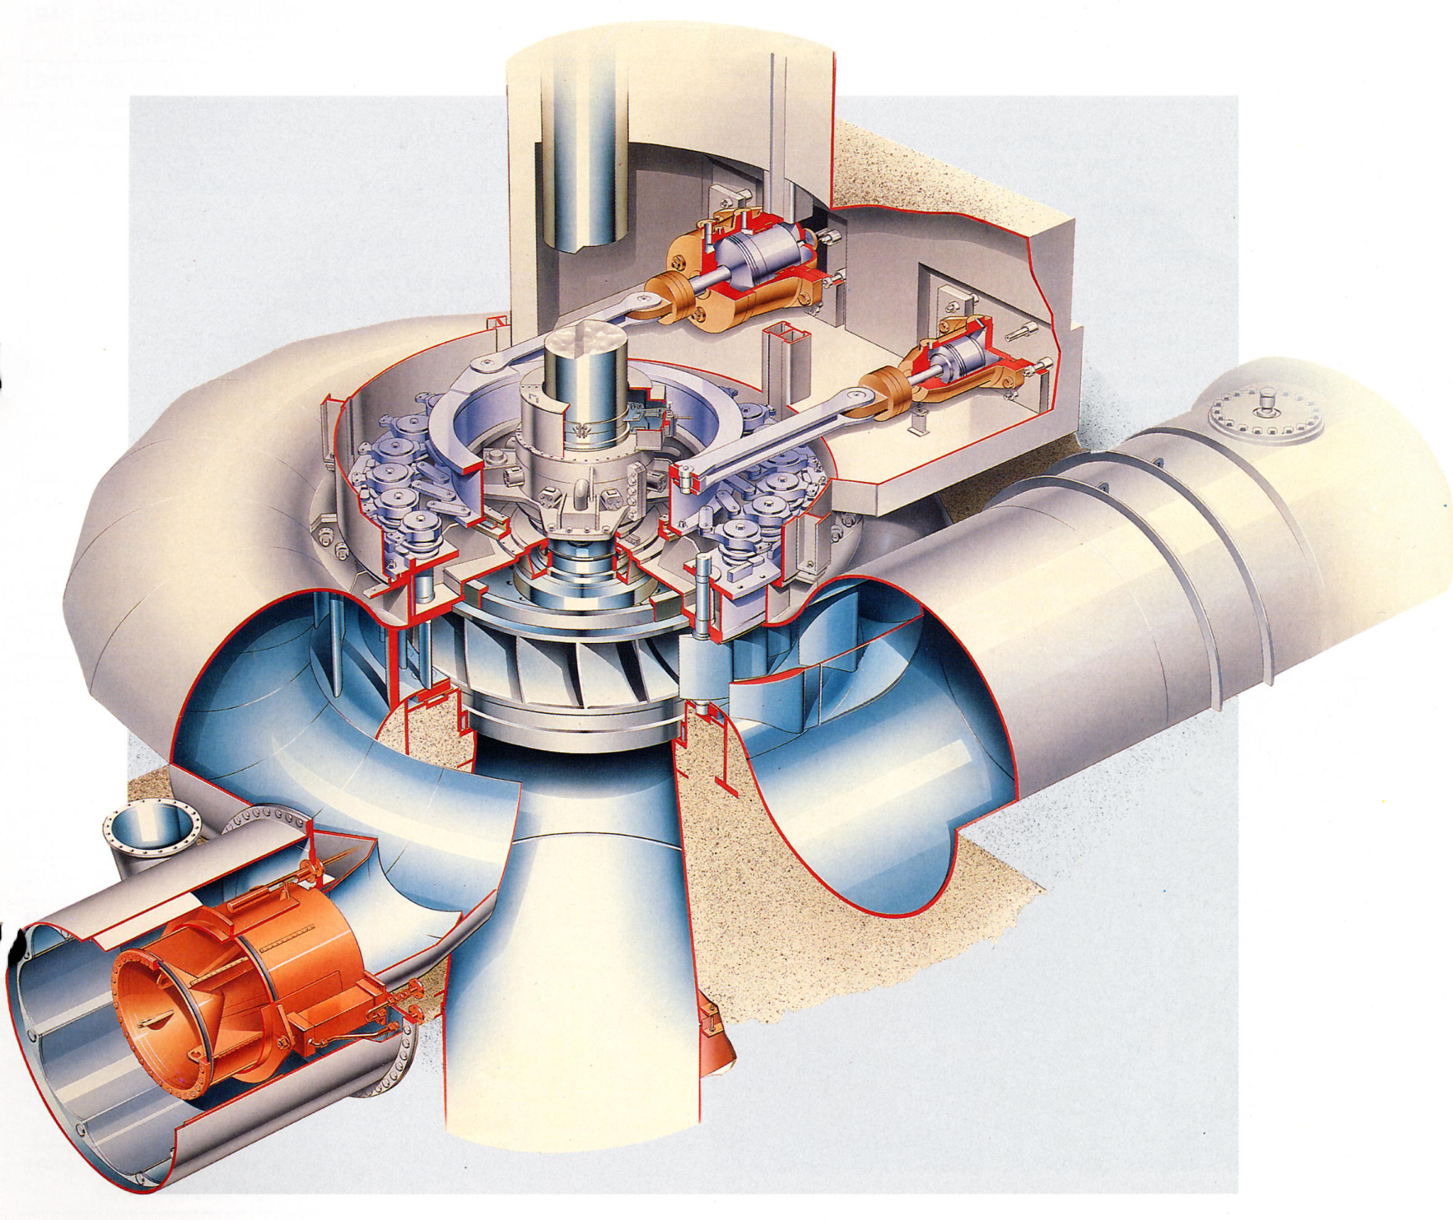
FRANCIS TURBINE – Vertical axis

Slide 21
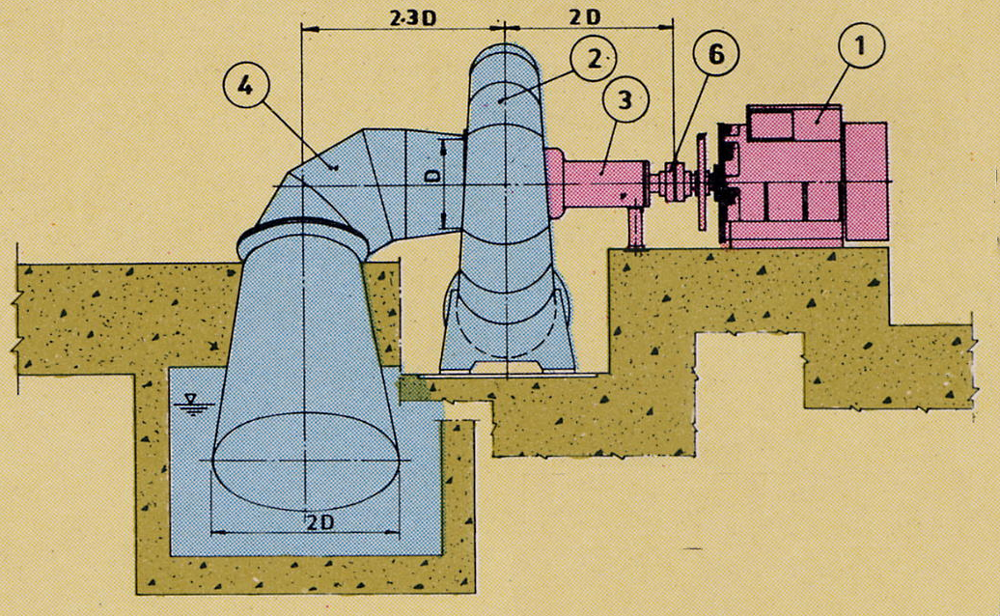
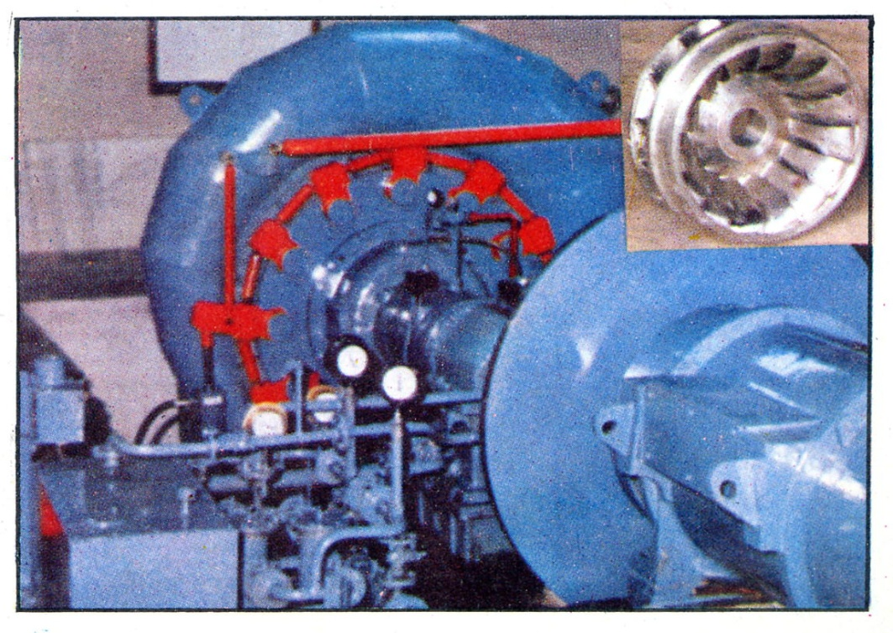
1 | GENERATOR
2 | SPIRAL CASING
3 | BEARING HOUSING
4 | DRAFT TUBE BEND
5 | DRAFT TUBE
6 | COUPLING
7 | BUTTERFLY VALVE
FRANCIS TURBINE – Horizontal axis

Slide 22
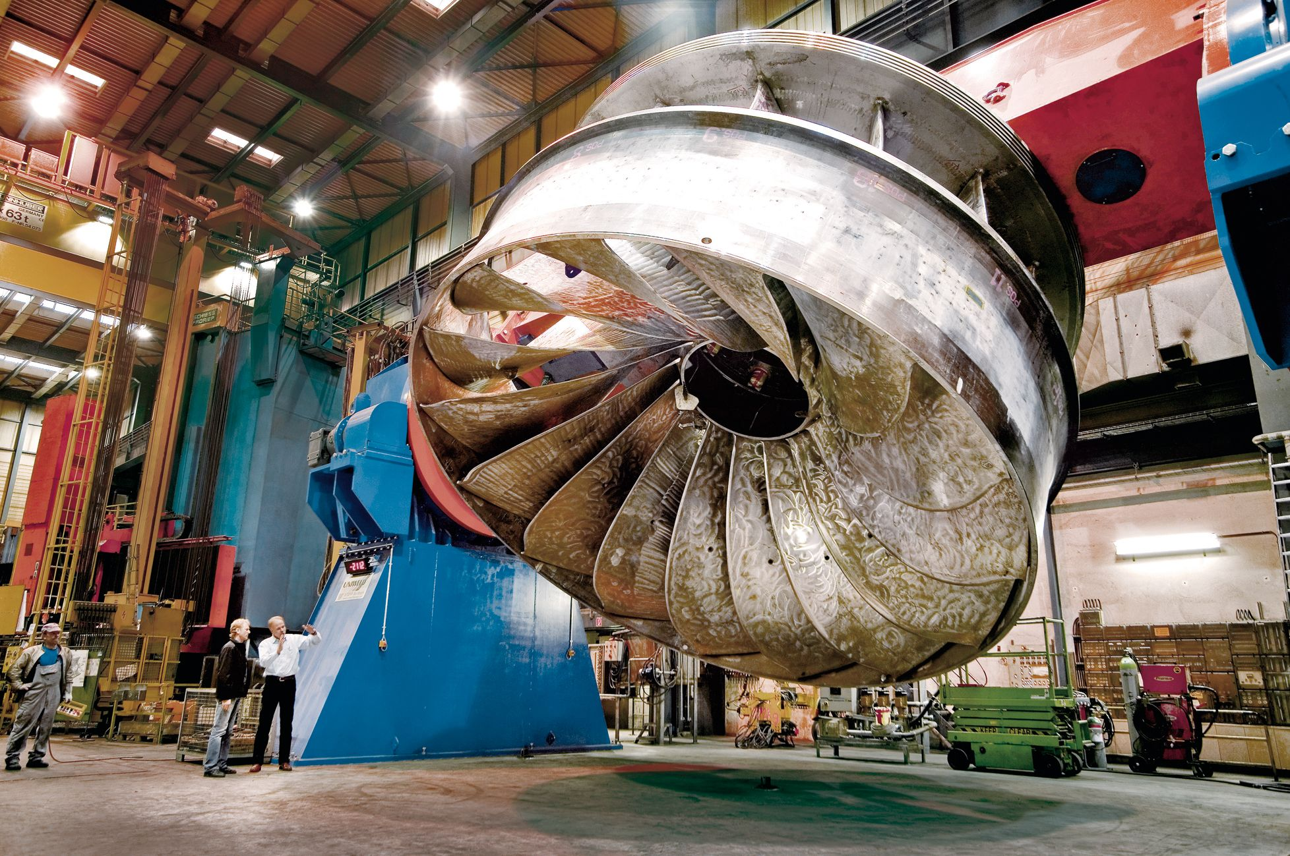
Installation of Francis turbine runner

Slide 23
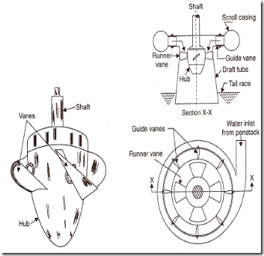
Kaplan Turbine

Slide 24
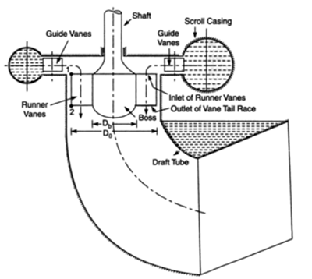

Slide 25
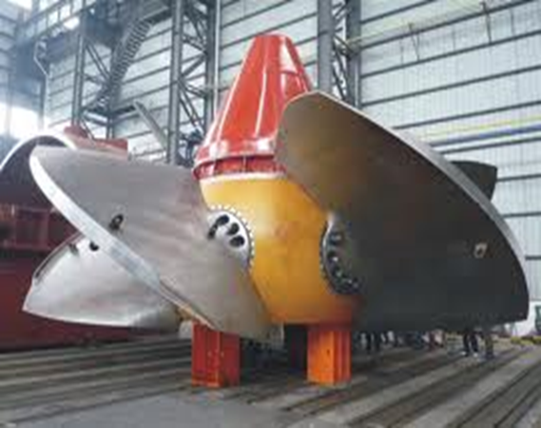

Slide 26
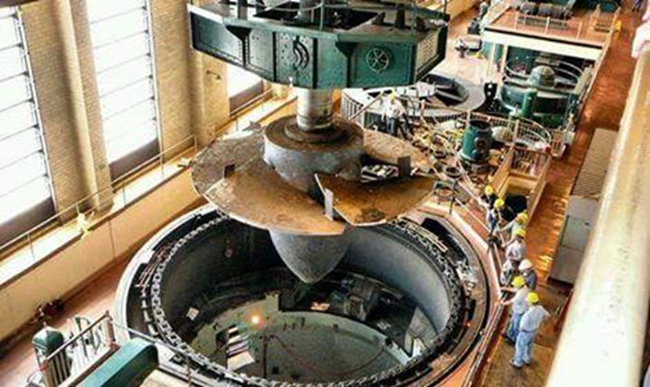
Installation of Kaplan turbine propeller

Slide 27
Main components
Propeller with movable blades
Guide vanes (or Wicket gates)
Spiral Casing
Draft tube

Slide 28
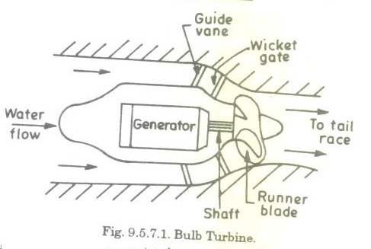
Bulb Turbine

Slide 29
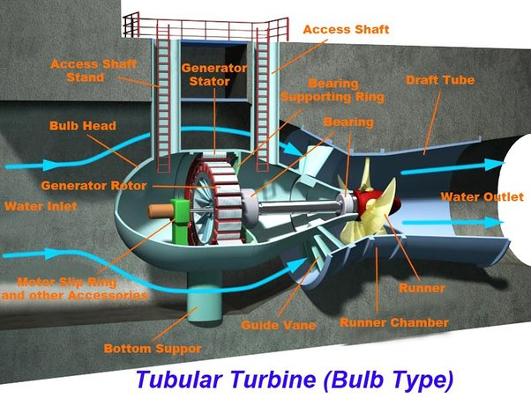

Slide 30
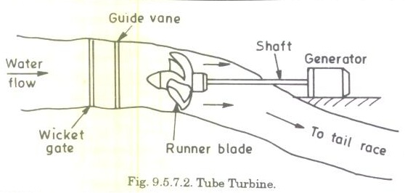
Tubular Turbine

Slide 31
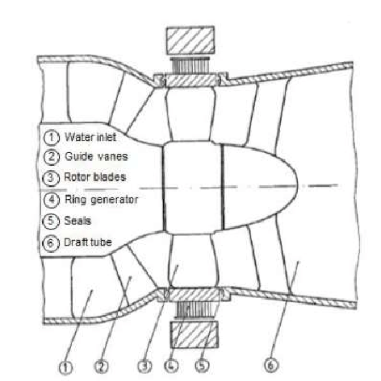
Straflow Turbine
The Straflo turbine is a type of reaction turbine that is used in low to medium-head applications, typically ranging from 3 to 50 meters.

Slide 32
THANK YOU

